Slide 1
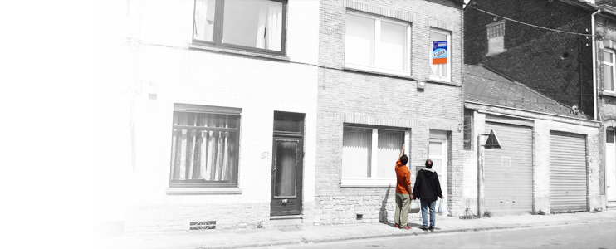





Slide 2
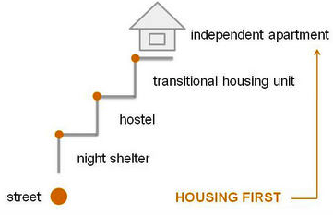
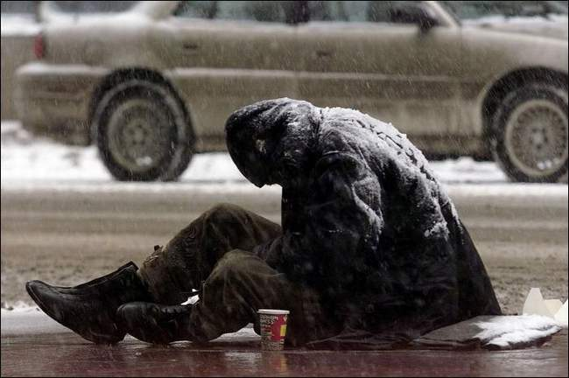
1. Staircase + focus winter
Notes:
Les pratiques HF sont menées en parallèle.
Mais ont été présentées comme une alternative d’emblée… donc ça fait des concurrents.
Principalement staircase+winter, même s’il y a des raccourcis vers le logement + accompagnement mais reste tjs un public discriminé (chronic + high/complex needs)

Slide 3
2. Time to test HF practices in Belgium

Slide 4
2. Time to test HF practices in BE

Slide 5
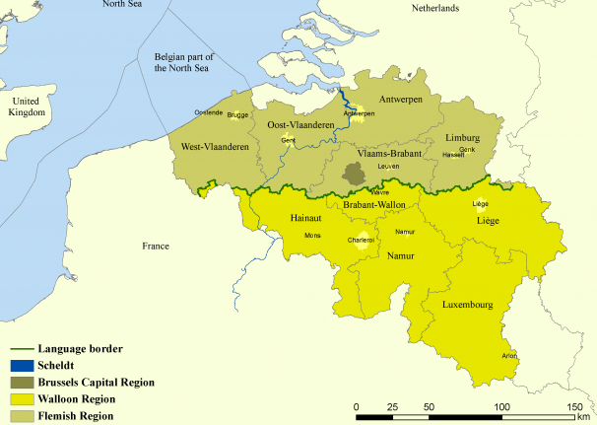
3. Eight sites – 3 regions
Brussels

Slide 6
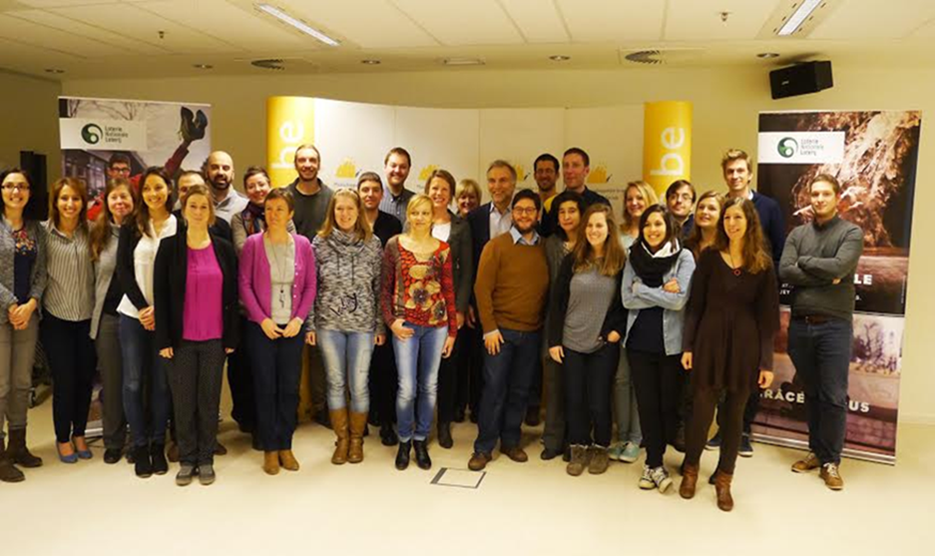
4. Eight HF support teams
They didn’t know that it was impossible, so they did it.
Mark Twain

Slide 7
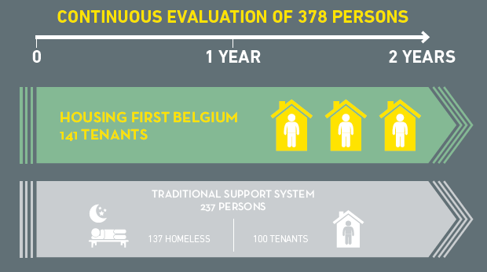
5. Systematic comparisons between/within groups

Slide 8

Housing first,
it also works in Belgium

Slide 9
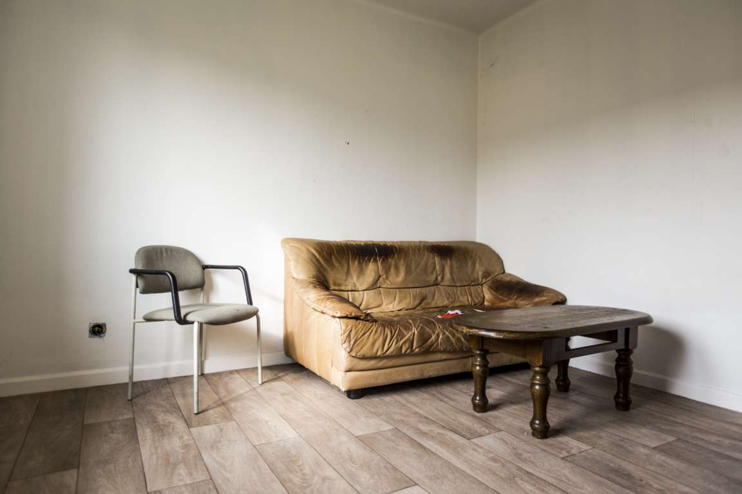
SECURITY and STABILITY

Slide 10
6. High housing retention

Slide 11
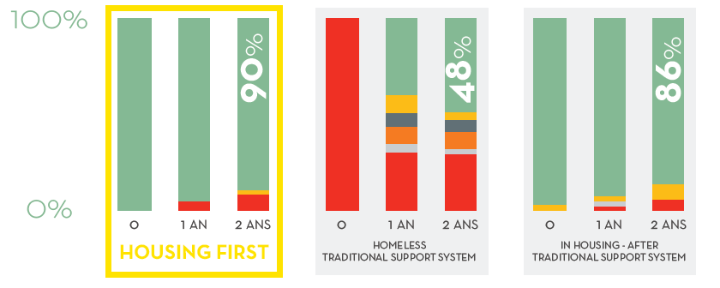
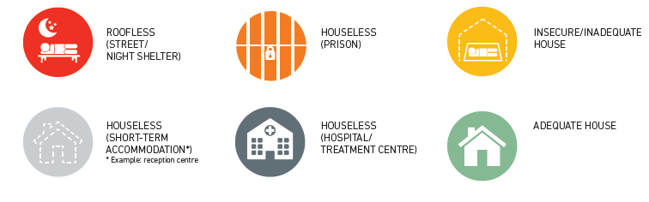
7. The best residential stability

Slide 12
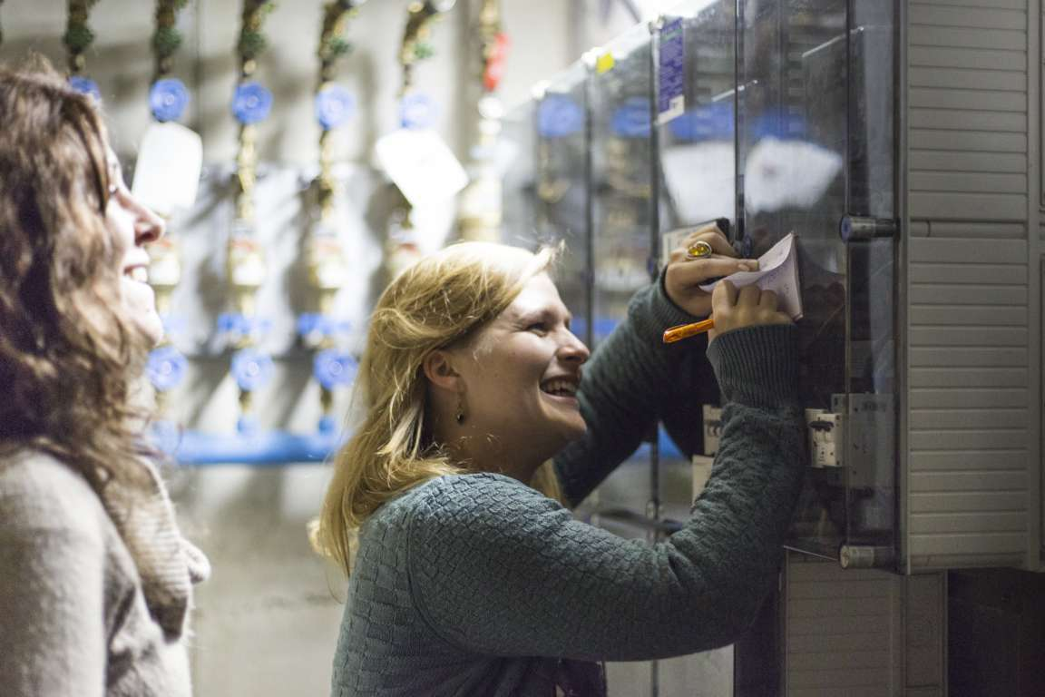
SECURITY and STABILITY
SOCIAL INTEGRATION

Slide 13
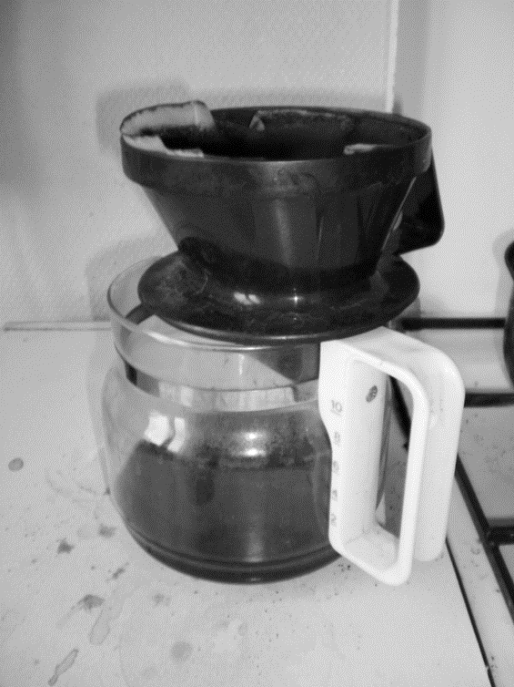
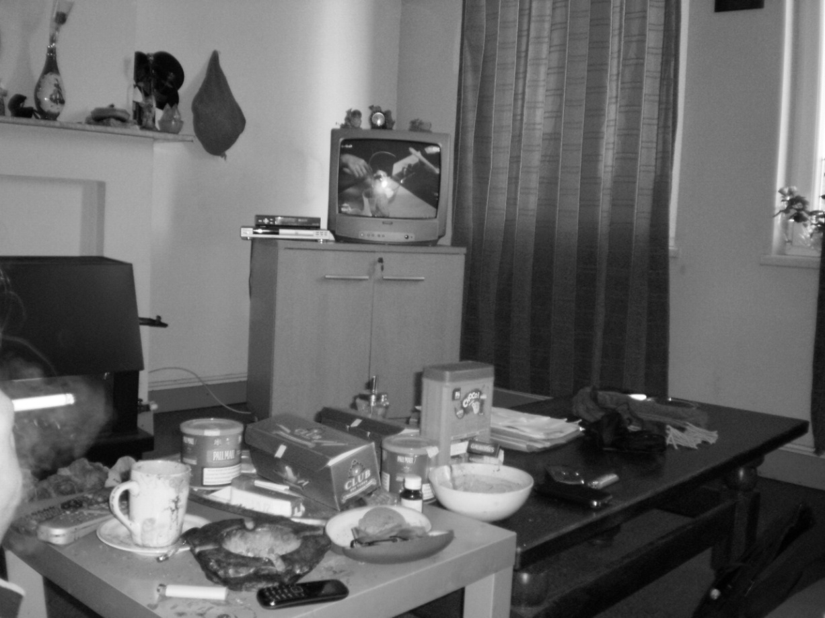
8. Housing facilitates social integration
Access to social rights
Access to training and work (10%)

Slide 14

SECURITY and STABILITY
SOCIAL INTEGRATION
RECOVERY

Slide 15
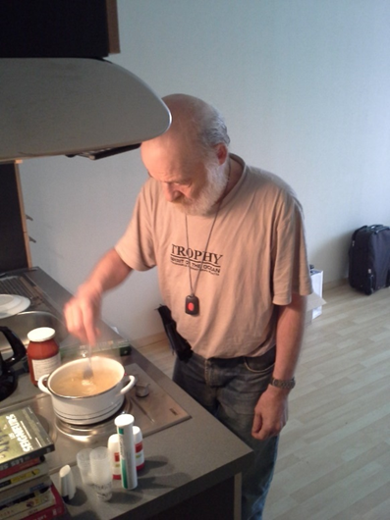
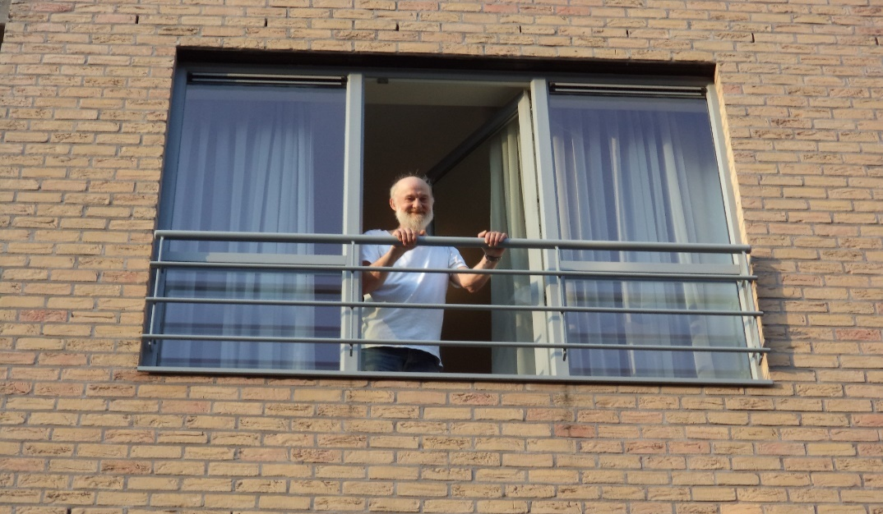
9. Housing facilitates recovery
Autonomy, Empowerment,
Self-esteem &
Self-care evolution

Slide 16
10. Even better health for HFB participants
Mental health: self-report

Slide 17
11. Housing first! What else?

Slide 18
13. Housing first! What else?

Slide 19


Slide 20

www.housingfirstbelgium.be
Facebook & Twitter: housingfirstbe
coordination@housingfirstbelgium.be

