Slide 1
Presentation Title
HOUSING FIRST IN ITALY:
Building Network, Making Innovation
Presentation title
Speaker’s name
Caterina Cortese
Speaker’s name

Slide 2
How was Housing First in Italy born
Since 2014 fio.PSD (the Italian Federation of Organization Working with Homeless People) launched the National Programme for Implementing Housing First in Italy
Broad consensus among fio.PSD’s members and not only
Participation of more than 100 social workers, managers, directors, public servants, scholars, researchers and students in the poverty sector were registered during the launch of the programme (Turin HF Conference)
Many organizations embrace this challenge and take part at this programme (social experimentation for 24 months)
On 1st march 2014 the Italian Network of Housing First was born under the coordination of fio.PSD

Slide 3
Chart
Fio.PSD
Network Housing first Italia
Supervision of the pilot projects
Training (US, Canada, Portugal, Spain, France, Italian Experts; summer/winter schools; webinars)
Scientific Committe
(5 Italian universities and Institute of research)
Impact evaluation of the
pilot projects (evaluation ex ante, in itinere, ex post)
www.fiopsd.org
www.housingfirstitalia.org

Slide 4
Membership
According to the Programme, each partner:
believes in HF principles
engages staff in training
starts with three apartments for HF users
subscribes an agreement with fio.PSD at standard fee
is available for evaluation activities of the Scientific Committee

Slide 5
Composition of the Network
52 members located in10 regions and 20 municipalities
47% not for profit, 33% Caritas, 12% other religious partner, 8% public
Other “supporters” (neighborhoods, counselling services, real estate, lawyers, parishes, volunteers, local shops, employment agency, help center)
110 social workers (psychologist, educators, sociologists, social workers)

Slide 6
Results
33 operative projects
343 HF users (55% single adults, 45% family homeless) [+ 167 children]
70% male, 30% female
50 years average age
63% roofless and houseless, 37% people living in insecure houses;
176 apartments
60% in private rental housing, 21% religious property, 19% public property)
26% single apartment; 43% apartment for families; 29% congregate housing (three people for room)
High levels of social integration (80% report that feel safe at home, 76% meet friends and other people outside, 68% enjoy the neighborhood
20 people recovered after one year
Source: IRES-FVG – University of Padova

Slide 7
Difficulties
Lack of national dedicated funds
Lack of minimum income for most vulnerable people
Lack of affordable and permanent housing
Cultural change/path dependency
Heterogeneity (context-oriented and target oriented projects) (…even if this is becoming a strength of HF Italy)

Slide 8
Added values
Net-work (working together, learning by doing, exchange of good practices, sharing between staff)
Respect of philosophy and adaptation of the local needs
Policy change
Enforcement of homelessness sector
Improvement of skills of social workers
Scientific Committee

Slide 9
If you want to start a HF project…
To invest in continuous training of the staff
To build a solid partnership and exchange between public and private organizations
To use HF as driver of change (policy change, cultural change, innovation, long-term vision)
… What else?
... Everyone has a secret!

Slide 10
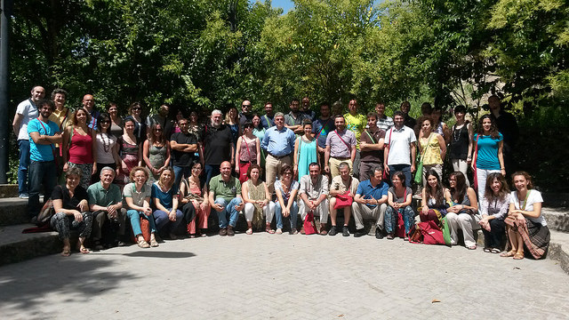
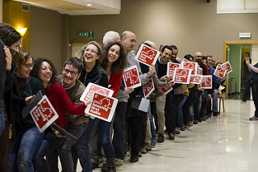
The faces of the Network
Summer school Ragusa 2014
Winter school Palermo 2015

Slide 11
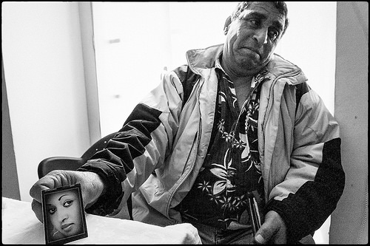
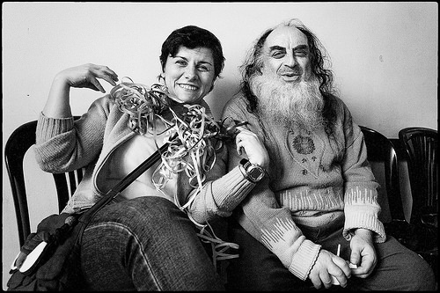
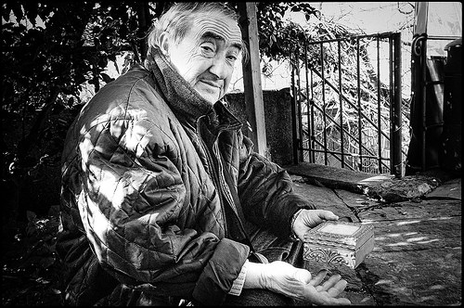
HF Users

Slide 12
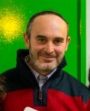
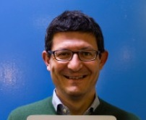
fio.PSD Staff for HF Italy
Cristina Avonto
fio.PSD President
HF services Provider
Alessandro Carta
(fio.PSD vice president)
Senior Trainer
HF services Provider
Domenico Leggio
fio.PSD Vice President
HF services Provider
Marco Iazzolino
Director of NHFI
Anita Adamo
Coordinator NHFI
Caterina Cortese
Coordinator Scientific Committee

Slide 13
Thank you caterina.cortese@fiopsd.org fiopsd@fiopsd.org

