Slide 1
Beyond Inequality: Expulsions
Saskia Sassen
Columbia University
www.saskiasassen.com
All graphs are based on the author’s new book:
Expulsions: Brutality and Complexity in the Global Economy
Harvard University Press 2014

Slide 2
BEFORE METHOD:
Analytic Tactics

Slide 3
Analytic Tactics
Destabilizing stable meanings
In the shadows of powerful explanations
When territory exits conventional framings:
it becomes institutionally mobile, nomadic and can alter the meaning of the “national” in its many diverse instantiations

Slide 10
Vulture Funds: one extreme case of aggressive innovation
Investing (profiting) off bankruptcies.
Corporate bankruptcies: ok, though can be destructive
Sovereign bankruptcies: a very different matter. An innovation in the context of intl system: typically end in lawsuits litigated in US courts. (They buy debt under explicit contract stipulations that differ greatly from govt and bank handling of sovereign debt).(Goes against Principles of International Comity that have and still rule the intl. system.

Slide 11
Continuing…
In Oct 95, a NY vulture fund (Elliott and Assoc) bought $28.7 mil of Panama debt for 17.5$ mil. In July 96 it brought suit in a US court against Panam govt for full payment of debt plus interest. Got the court to approve and force P govt to pay 57 $ mil.
Same fund, same story, other govt: in March 96 bought 20.7$ mil in Peru govt debt from intl. banks for 11.4$ mil with a contract under NY law. In Oct 96 filed in NY State Supr Crt for 35 mil incl inrterests: 58 mil$
In 1998 alone, Elliott went ag Ecuador, Ivory C,Poland, Congo. It collected 100 mil$ through its Ecaud and Vietnam suits. And prevented through legal injuctions, creditors in Canada, Neth, Germany, Luxemb, and Belgium from collecting before they did.

Slide 12
  WHAT IS THE STEAM ENGINE OF OUR EPOCH

Slide 13
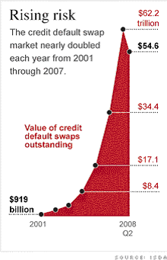

Slide 14
When modest neighborhoods become part of global finance
1. They key is that the source of profits for financial firms of sub-prime and other mortgages for low- and modest-income households is NOT payment on the mortgage.
2. The source of profits is the bundling of a large number of these mortgages to sell them on to investors, including banks and foreign investors. It worked because they were mixed up with high quality debts of all sorts.

Slide 15
Expulsions: Foreclosures
2006 : 1.2 million foreclosures, up 42% from 2005. This is: One in every 92 U.S. households
2007: 2.2 million forecls, up 75% from 06
2008: 3.1 million, up 81% from 07
2009: 3.9 million (or 1 in 45 US hholds)
(From 2007 to 2009: 120% increase in forecls)
2010: 2.9 mill forecls. (2006-2010: over 13 mil)
Source: RealtyTrac 2007, 2008, 2009, 2010; Blomquist 2011

Slide 16
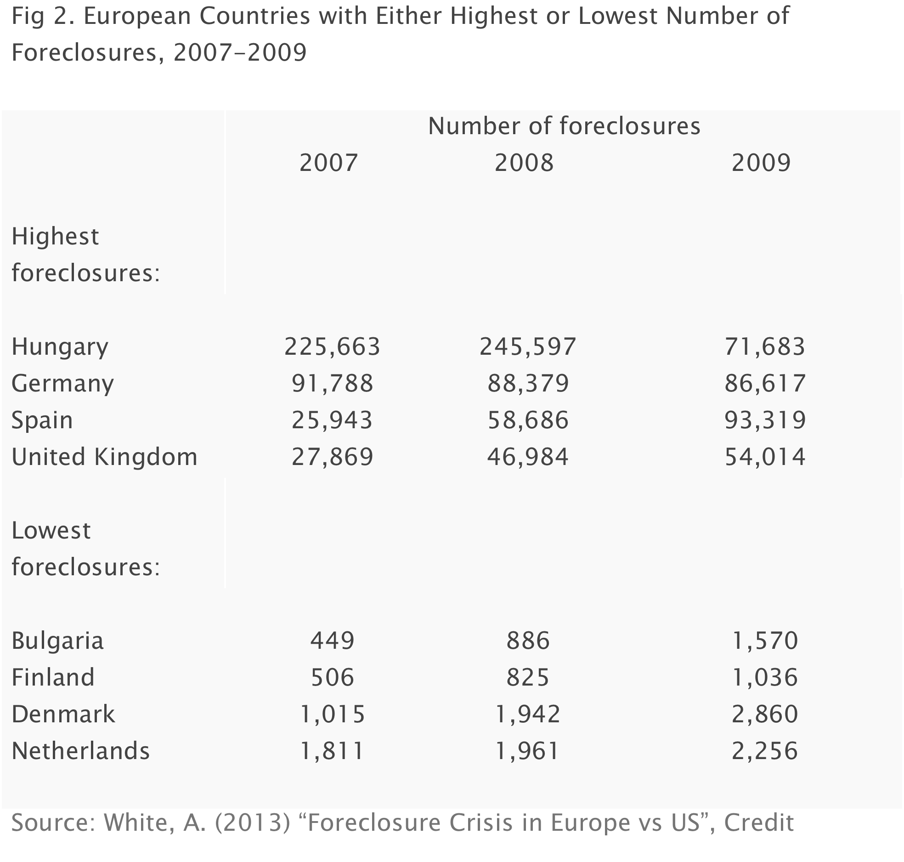

Slide 17
Table 8: Ratio of Household Credit to Personal Disposable Income (2000-05)
 | 2000 | 2001 | 2002 | 2003 | 2004 | 2005
Emerging Markets
Czech Republic | 8.5 | 10.1 | 12.9 | 16.4 | 21.3 | 27.1
Hungary | 11.2 | 14.4 | 20.9 | 29.5 | 33.9 | 39.3
Poland | 10.1 | 10.3 | 10.9 | 12.6 | 14.5 | 18.2
India | 4.7 | 5.4 | 6.4 | 7.4 | 9.7 | …
Korea | 33.0 | 43.9 | 57.3 | 62.6 | 64.5 | 68.9
Philippines | 1.7 | 4.6 | 5.5 | 5.5 | 5.6 | …
Taiwan | 75.1 | 72.7 | 76.0 | 83.0 | 95.5 | …
Thailand | 26.0 | 25.6 | 28.6 | 34.3 | 36.4 | …
Mature Markets
Australia | 83.3 | 86.7 | 95.6 | 109.0 | 119.0 | 124.5
France | 57.8 | 57.5 | 58.2 | 59.8 | 64.2 | 69.2
Germany | 70.4 | 70.1 | 69.1 | 70.3 | 70.5 | 70.0
Italy | 25.0 | 25.8 | 27.0 | 28.7 | 31.8 | 34.8
Japan | 73.6 | 75.7 | 77.6 | 77.3 | 77.9 | 77.8
Spain | 65.2 | 70.4 | 76.9 | 86.4 | 98.8 | 112.7
United States | 104.0 | 105.1 | 110.8 | 118.2 | 126.0 | 132.7
Source: IMF Staff estimates based on data from country authoriies, CEIC, OECD, and Bloomberg

Slide 18
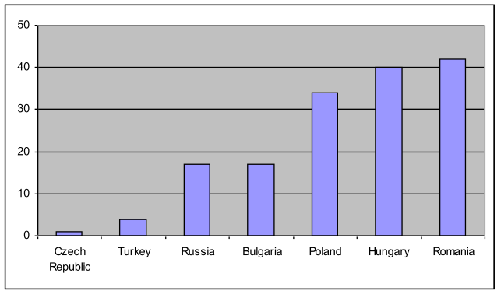
Table 11: Share of Foreign-Currency-Denominated Household Credit, End-2005 (In percent of total household credit)
Source: IMF 2006. “Global Financial Stability Report: Market Developments and Issues.” IMF: World Economic and Financial Surveys. September, 2006. Retrieved August 26, 2008. [http://www.imf.org/external/pubs/ft/GFSR/2006/02/pdf/chap2.pdf] p. 54

Slide 19
Super-Prime Housing Market
Monaco 18.9 million $
Russian, CIS, UK, Italian, Scandinavian, Swiss
London 15.9 million$
Russian, French, South African, Italian, Indian, UAE, Greek, Australian, US, Canadian
New York City 10 million$
UK, French, Italian, Spanish, Mainland Chinese, Singaporean, Australian, Brazilian, Argentine, Canadian

Slide 20
more
Dubai $8.0m
African (Kenyan, Somali, Tanzanian), Saudi Arabian, Russian, Indian, Iranian
-Paris 8.8 million$
Russian, CIS, Middle Eastern, Italian, French, Benelux, German, UK, US
Moscow $7.8m CIS

Slide 21
More
-Singapore 8.3 m$
Indonesian, Mainland Chinese, Malaysian, Indian, Australian, UK
-Shanghai 6.4 million $
Hong Kong,Taiwanese, US, Canadian, Korean, Singaporean, Australian, Japanese, Malaysian, German, French
- Hong Kong 15.4 m$
Mainland Chinese

Slide 22
In the shadows of “urbanization”
.

Slide 23
One instance
From 2006 to 2010: 220 million hectares of land in Afri ,LatAm, Cambodia, Ukraine bought/leased by rich govts,firms,financial firms
The land is now more valued than the people or activities on it
The active making of surplus populations
Novel assemblage of Territory/Authority/Rights

Slide 24
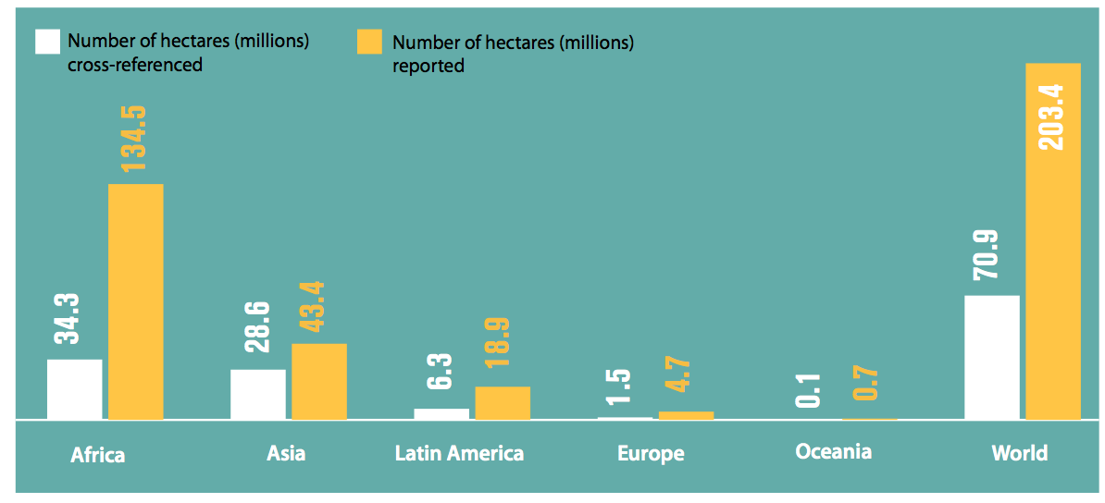

Slide 25
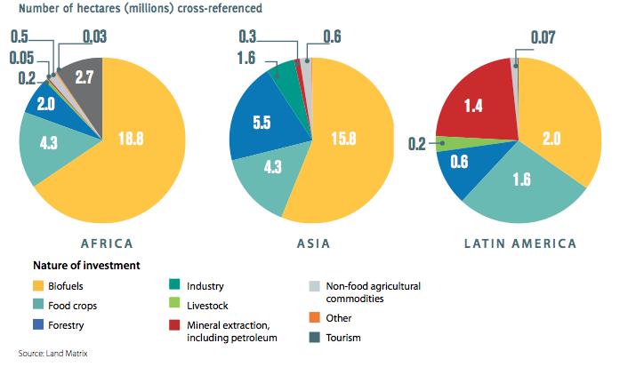

Slide 26
UNSTABLE MEANINGS
Membership in a nation-state

Slide 27
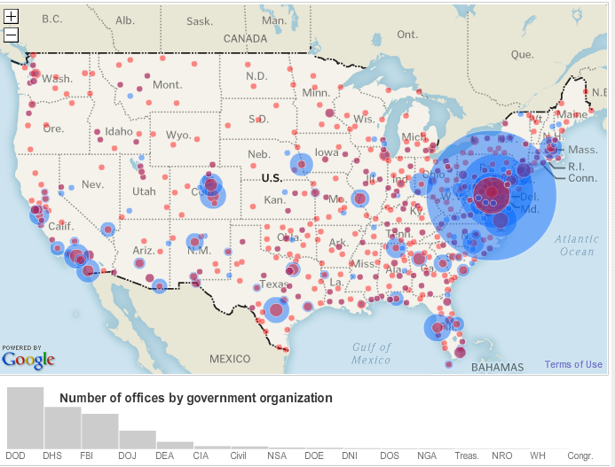
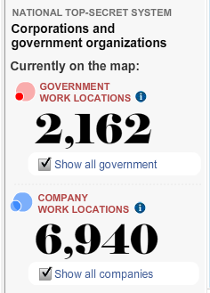
Map of government and private security agencies in the US
Source: Washington Post. 2010. “Top Secret America,” Interactive Maps. Washington Post, July 2010. http://projects.washingtonpost.com/top-secret-america/map/

Slide 28
More buildings
In Washington and the surrounding area, 33 building complexes for top-secret intelligence work are under construction or have been built since September 2001.
–Together they occupy about 17 million square feet – the equivalent of almost three Pentagons or 22 US Capitol buildings.

Slide 29
The Global Street
A space for making by those who lack access to formal instruments for making.
-making presence/estamos presentes
-no explicit (conventional, standard) objective
Urban capabilities –arising out of a mix of people and space
Does the City Have Speech

Slide 30
