Slide 1
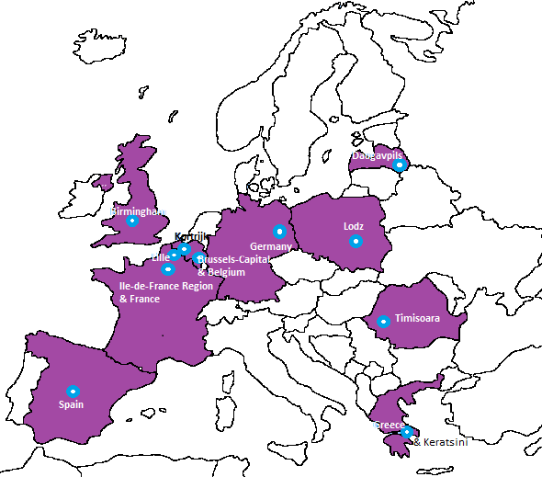
Members of the partnership
Cities
Birmingham (UK)
Daugavpils (LV)
Kortrijk (BE)
Lille (FR)
Lodz (PL)
Timisoara (RO)
Keratsini (GR)
Regions
Brussels-Capital (BE)
Ile-de-France (FR)
Member
States
Belgium
France
Germany
Greece
Spain
Organisations
Full-members:
URBACT
EUKN
EAPN (tbc)
Observers:
UN Habitat
Eurochild
FEANTSA
Commission
DG REGIO
DG EMPL

