Slide 1
Presentation Title
Landlords: Public and Private Partners.
Different forms of Social Housing – Advantages and Challenges
Presentation title
Speaker’s name
Maria Clemensen, head of the ACT-Team and Housing First in Copenhagen, Denmark
Speaker’s name

Slide 2
Agenda
1. Experiences and results so far – homeless support in Copenhagen
2. Housing in a Danish context
3. Challenges and goals for the future

Slide 3
1. Experiences with homeless support in Copenhagen and results so far
A National Danish Homeless Strategy 2009-2013 - Reduce the number of homeless citizens - Test Housing First and different methods of social support (ICM, CTI and ACT)
Today permanent ACT and CTI programs anchored in the Homeless Unit in Copenhagen
The National Board of Social Services is facilitating a program focusing on expanding the results from the Danish Homeless Strategy – e.g. Housing First and ACT, CTI, ICM

Slide 4
My primary team: Assertive Community Treatment - ACT
Multidisciplinary team consisting of psychiatrists, addiction councilors, social support workers, job center workers
Outreach and floating support
Streamlining coordination across sectors
Long term support – support is given as long as needed
Flexible support and treatment programs based on individual needs

Slide 5
Results so far
ACT and CTI support works!
Around 90 % former homeless keep their housing
Housing First has made it possible to house people with substance abuse, mental illness, chaotic lifestyles etc. in regular housing
Housing First has made it possible to reach and treat people with health problems and addiction in a much better way

Slide 6
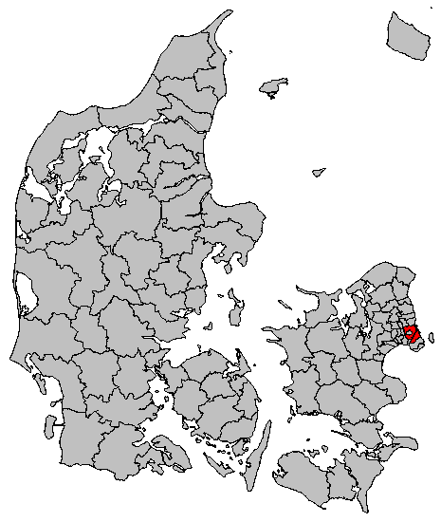
Copenhagen: The Capital of Denmark and the largest municipality in Denmark
Notes:
Around 570.000 people live in the Copenhagen municipality.
As of 2015 around 2 million people live in The Greater Copenhagen area (which consists of the 18 municipalities Copenhagen, Frederiksberg, Gentofte, Gladsaxe, Lyngby-Taarbæk, Ruderdal, Hørsholm, Herlev, Ballerup, Høje Taastrup, Glostrup, Albertslund, Rødovre, Hvidovre, Brøndby, Vallensbæk, Ishøj, Dragør andTårnby.) . This is 35 % of Denmarks population live in the Greater Copenhagen area.
Copenhagen can be traced back historically to around year 800, where there was a tiny fishing village where todays city center now lies. From around the 1300’s the city became the countries richest and most important city – mostly because of its strategic location in regards to Øresund. Copenhagen is today largely believed to have been founded by Bishop Abselon, who buildt the first castle here around 1067. The remains of this castle can today still be seen under Christiansborg (The castle that houses The Danish Parliament). Today around 22% of the population in Denmark live in The Greater Copenhagen area.

Slide 7
Housing in a Danish Context
Danish housing is a regulated market —a by-product of the Danish Welfare State
Denmark has a tradition for a large amount of public housing – 20 % of all housing in Copenhagen (CPH)
Of the 20%, every 4th public apartment goes to the municipality by law. In CPH every 3rd apartment
Most public housing in CPH are apartment buildings (scatterede) but some are congregate housing – we use both in ACT

Slide 8
Public Housing in Denmark
Agreements made with all the Public Housing Organisations:
The Municipality compensates almost all expenses eg. when tenants move out from a ruined apartment, when an apartment isn’t rented out immediatly etc.
Regular contact:
Meetings and overall agreement
Organised flow of appartments: Copenhagen has acces to around 850 a year
Contact when tenants are behind on their payment or in situations of conflict

Slide 9
Our Results Thus Far
Very few evictions
Early help from the ACT team to the tenant in situations of conflict
Good dialogue with housing organisations even in conflict situations – developing working relationships
Housing and support is seperated in the structure itself – it doesn’t come from the same source
The tenants’ ACT-worker helps in the dialogue – and sometimes the ACT-boss!

Slide 10
Possible solutions in conflicts between tenants and landlords
Help in the timely paying of rent
Help the tenant understand neccesary behaviour in an apartment building:
noise, guests, empty mail box, take out garbage, keep dog on leash, talk nicely to neighbours etc.

Slide 11
3. Challenges
Copenhagen attracts a constant flow of people – and more homeless. 1.000 new citizens in Copenhagen every month
A marked decrease in affordable housing
55% loss of apartments under 3.000 kr./month since 2007
Ceiling on cash benefits
Affects at risk citizens’ ability to pay rent
Our clients need to be able to afford rent—by law we are not allowed to subsidise their housing
We know our methods work, but it is not possible without enough housing

Slide 12
Acces to housing in Copenhagen
Housing that at risk citizens can acturally afford
Private renting
Privately Owned homes
Cooperative housing
1/3 of public housing goes to at risk citizens
Public housing
80 %
20 %

Slide 13
Why not Housing First in the private market in Copenhagen?
As a public organisation we are not allowed to own and rent out privately – to compete with the market
By law it is not possible to compensate private landlords economically the way we are able to compensate the public housing organizations

Slide 14
Goals for the future
Access to a larger amount of affordable housing
And good housing, not just a new (cheap) slum
At risk tenants more spread out in various housing forms in Copenhagen – both private and public market
New creative ways of housing eg. ‘Skæve boliger’, sharred housing

