Slide 1




Presentation Title
How can interdisciplinary support better answer the multiple and complex needs of the Housing First target group?
Presentation title
Speaker’s name
TORREGROSSA Bruno
VILT Olivier
Speaker’s name

Slide 2
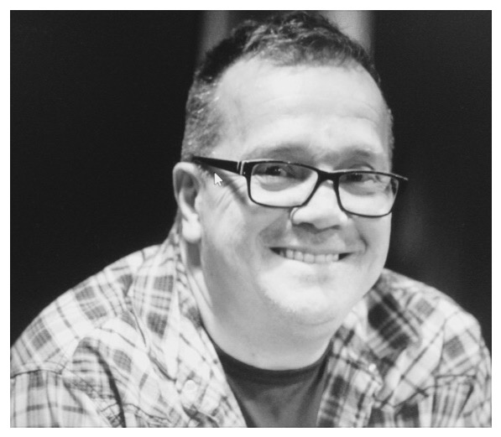
In memory of, our colleague, Louis-François

Slide 3
Lille
(100 tenants)
Team Composition
Paris
(60 tenants)
Nurses : 3,5 ETP
Psychologist : 1 ETP
Social workers : 6 ETP
Peer workers: 2 ETP
Psychiatrist : 0,7 ETP
Secretary : 0,6 ETP
Coordinator : 1 ETP
Capture Housing : 1 ETP
Housing rental management : 1 ETP
16,8 ETP
Nurses : 2 ETP
Psychologist : 1 ETP
Social workers : 3,9 ETP
Peer workers: 1,3 ETP
Psychiatrist : 0,5 ETP
General Practitioner : 0,5 ETP
Assistant/Secretary : 1,4 ETP
(with housing management missions)
Coordinator : 1 ETP
11,6 ETP

Slide 4





Missions
Propose to get better
Wellness and recovery

Slide 5



One for all, all for one !
Always in pairs
Common bases
For a convergence of views

Slide 6


Competences
Professional skills
Personal experiences
AND :
Creativity
Autonomy
Adaptability
Positive energy

Slide 7


Collaboration with many different services, success in implementation
Our services are provided through a pre existing network.
It develops depending the tenants dream.

Slide 8

Added value of the multi disciplinary team
Statuses of the professionnals fluidify the relations
Complementary of points of view
Do not remain center on a problem, but have a global vision

Slide 9

Types of collaborations
Meetings
Summaries
Common accompaniments

Slide 10

Sharing experience
training interventions with tenants
Seminars and meetings on the exchanges of practices
We get professionals from other services for common workdays...
“Saw my job” with colleges from others services

Slide 11
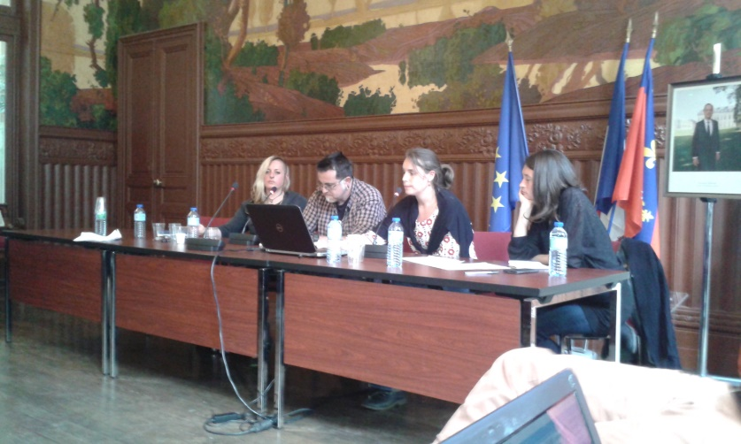
Sharing experience (again and again and…!)
Seminars and presentations in our own institutions / internal partnership
Team and institutional holders meetings
Sharing about oriented recovery philosophy and practices
(In France, it’s only the beginning!)

Slide 12
3 ingredients of the success
The developed link with the people , beyond the professional (...) related to the sharing of experience
Multi Reference : multiple visions ,
The tools do not stop to professionals skills and are complemented by the personals experiences of professionals.

Slide 13
3 current challenges
Discipline : monitoring human goals
Have sufficient staff number to be available
Do not focus only on people in low energy and take advantage of those who are high energy.

Slide 14
Presentation Title
Thank you for your attention.
Presentation title
Speaker’s name
Speaker’s name

